Slide 1
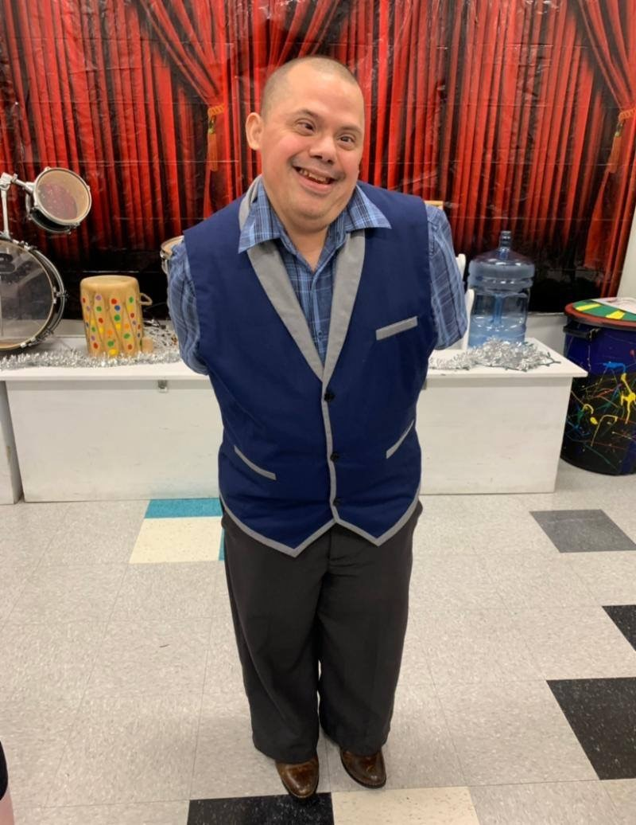
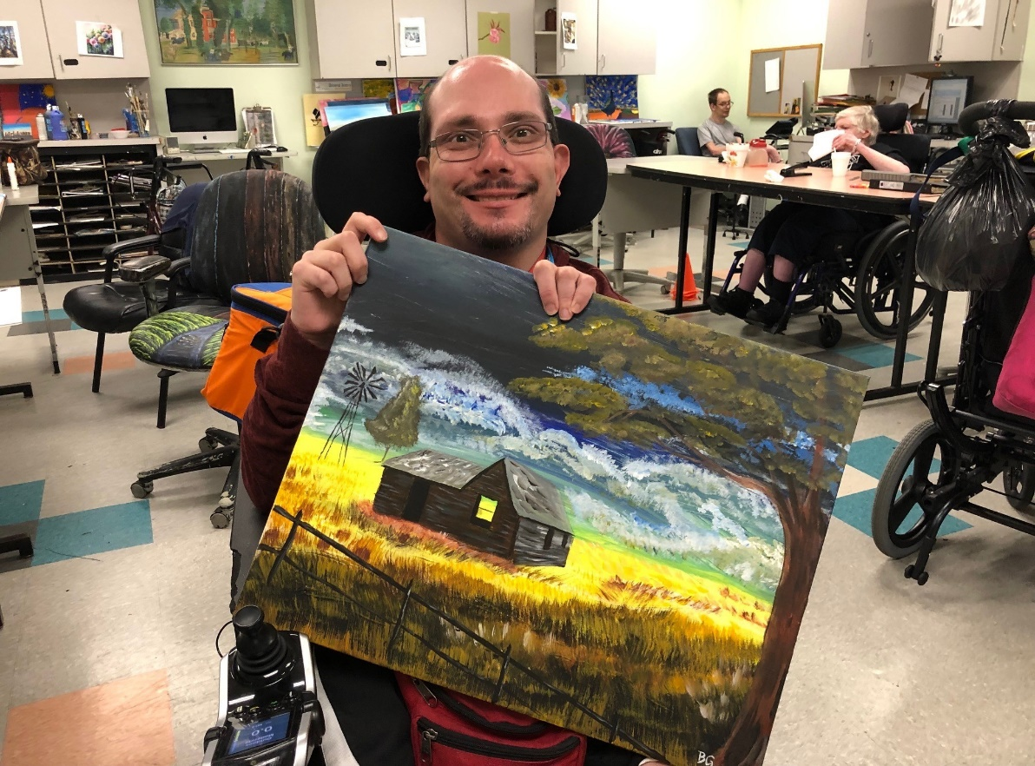
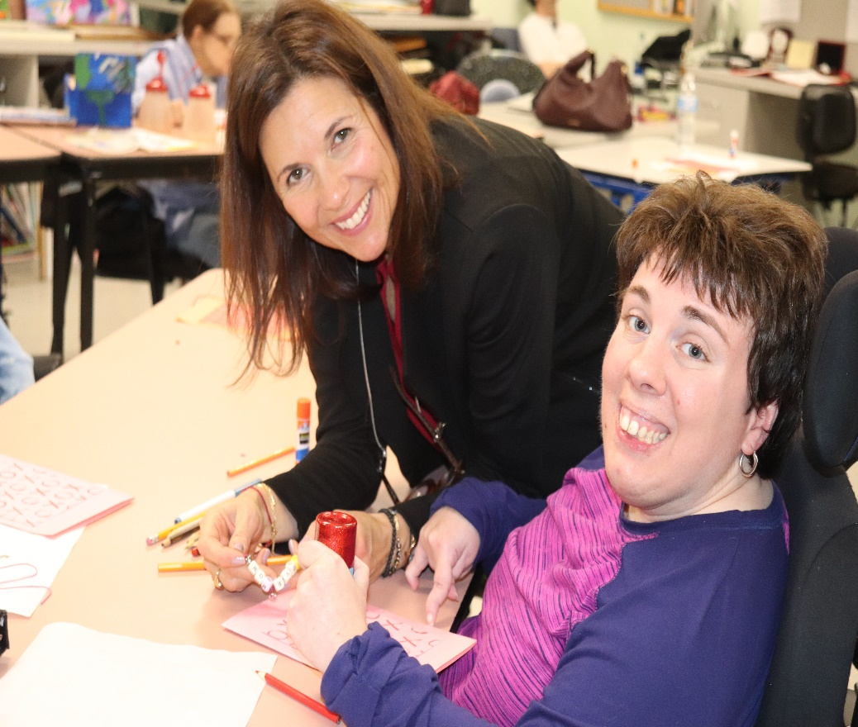
2019 ANNUAL REPORT
Our MISSION is to advance the independence, productivity and full citizenship
of people with cerebral palsy and other disabilities.

Slide 2
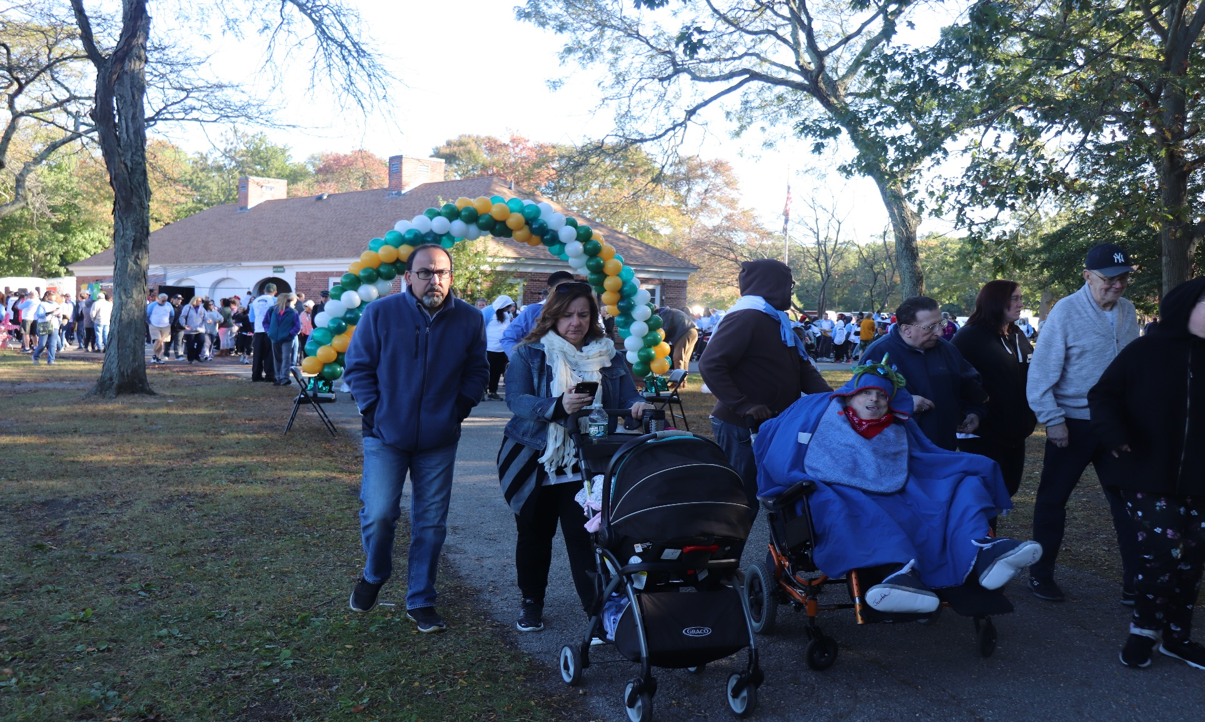
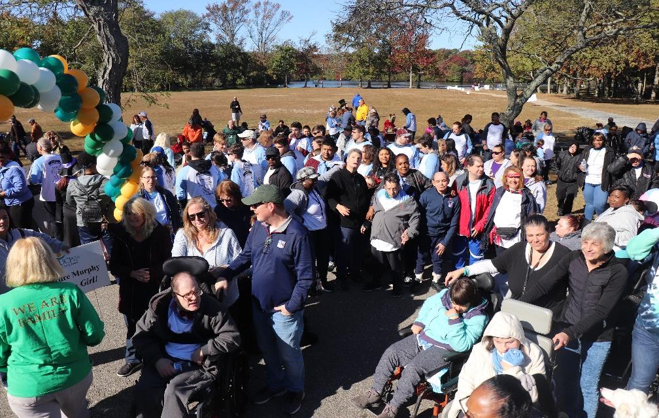
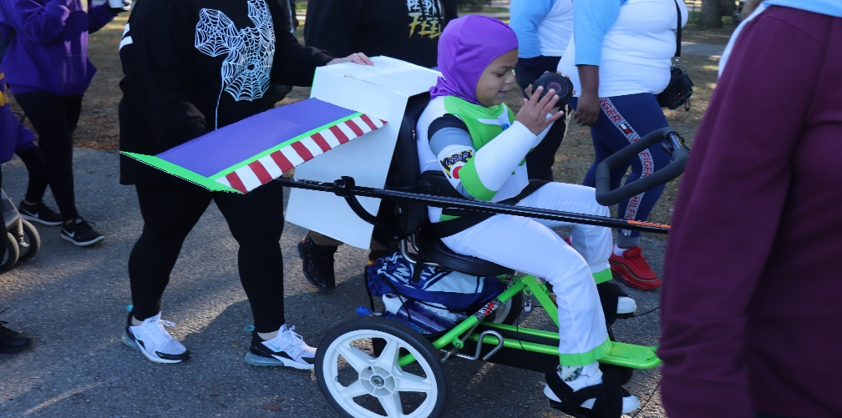
UCP-LI 5K Walk N Wheel
Did you know….
35% of children and adults we serve have cerebral palsy; an astounding 65% of those we serve have disabilities other than cerebral palsy

Slide 3
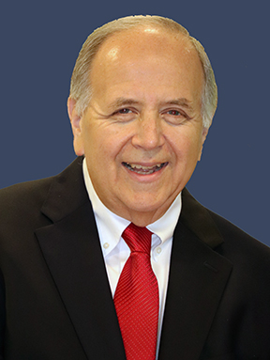
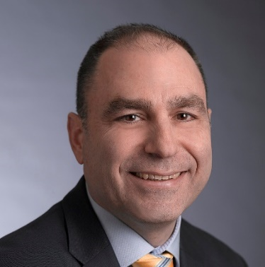
Creating Life Without Limits
Stephen H. Friedman, In Memoriam June 2019
As President and CEO, Steph encouraged incredible growth and transformation in the lives of the children and adults we serve. Steph passed away suddenly in June 2019 and he is greatly missed.
Each day, our individuals thrive and live a Life Without Limits due to our quality programs and services. The Children’s Center gives children with disabilities a chance at a brighter future. Our Adult Day Service Programs provide our participants with an opportunity to express themselves and to contribute to society through art, music and advocacy. The Residential Program includes 31 beautiful homes where individuals receive physical and emotional support from loving staff, who have become a second family to them. This is all made possible through the extraordinary generosity of our partners, supporters and friends.
Steph’s leadership and dedication to our mission enabled some many wonderful things to happen during his 20 year tenure and we remain forever grateful.
Thomas Pfundstein, Chair of the Board of Directors
I have been involved with UCP of Long Island for more than a decade. I first learned of how extraordinary UCP of Long Island is through my son, Joseph, who attends the Children’s Center. The Children’s Center provides excellent educational programs to more than 80 infants and children with disabilities, using assistive technology services and innovative programs. These programs combined with the Center’s compassionate staff enables each child to thrive. My son has flourished as a result of the outpouring of love, support and encouragement that the staff at the Children’s Center has provided. Joseph has a chance to live a Life Without Limits, thanks to UCP of Long Island.
After reading about all of the incredible services we provide in this annual report, I ask that you please consider scheduling a tour of our facilities to see all of the exemplary work that your donations support. To schedule a tour, contact the Office of Development at 631-232-0015 and come see first hand the amazing programs and services offered to children and adults on Long Island.

Slide 4
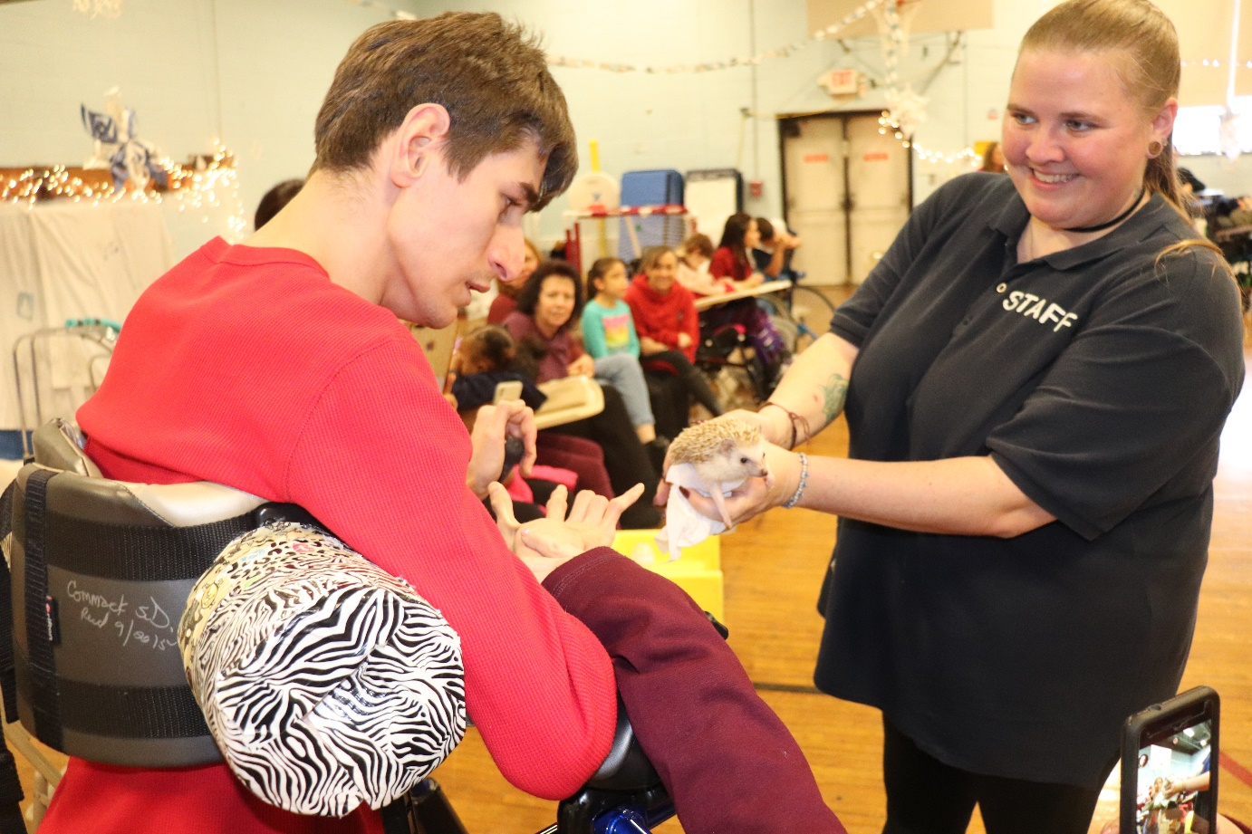
Creating Life Without Limits
The Children’s Center
UCP of Long Island Children’s Center is committed to creating a Life Without Limits in the lives of children with disabilities through an educational partnership joining home, school and the community. The Children’s Center, located in Commack, has provided over 36 years of excellence in educational services including preschool, school-age programs and early intervention services tailored to meet the physical, cognitive and emotional needs of children with disabilities from birth to 21 years of age.
“You're off to Great Places! Today is your day! Your mountain is waiting, So... get on your way!” ― Dr. Seuss, Oh, The Places You'll Go!
In 2019, 13 students were celebrated during our Annual Graduation/Moving Up Ceremony at the Children’s Center

Slide 5
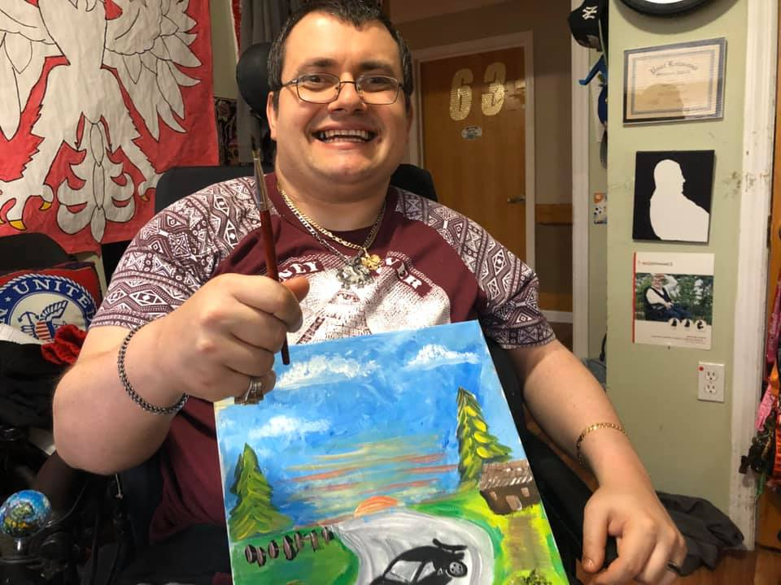
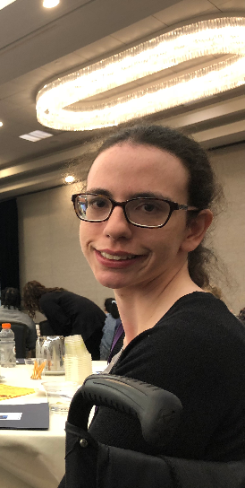
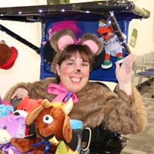
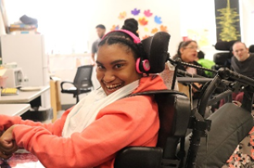
Creating Life Without Limits
Residential Services
UCP of Long Island provides residential care in 31 homes in Suffolk County for individuals with disabilities. Every home is beautifully maintained both outside and inside and becomes an integral part of each neighborhood. Individuals receive services in a comfortable and fully accessible home and are encouraged to achieve independence and live active lives. Residents regularly enjoy taking part in community outings and events. We encourage the involvement of families in these activities to further our goal of helping individuals live Life Without Limits.
“The best and most beautiful things in the world cannot be seen or even touched- They must be felt with the heart.” – Helen Keller
We provide residential services to over 224 adults and children with disabilities.

Slide 6
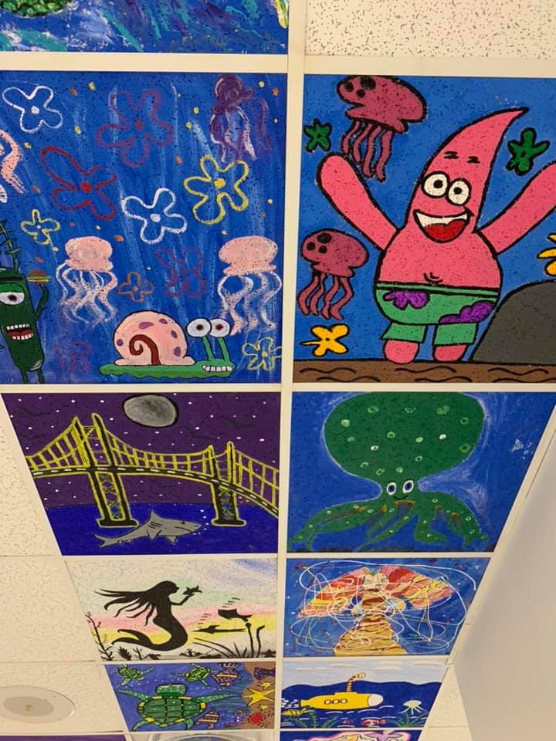
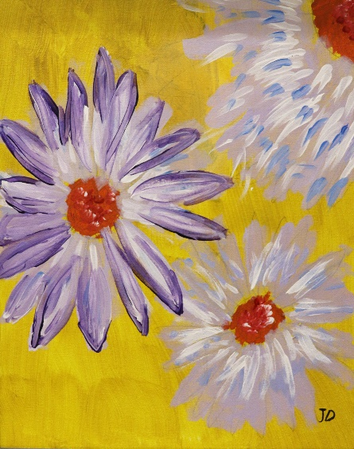
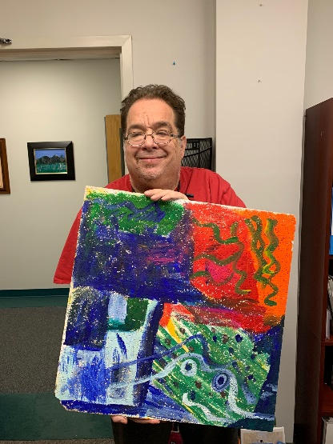
Creating Life Without Limits
ADULT DAY SERVICES
Brushstrokes Program
The Brushstrokes Program
gives participants an
opportunity to create
intriguing pieces of artwork
that reflect their dynamic personalities. The program consists of more than
20 artists who paint each
day. Their work has been displayed in community art exhibits and at UCP of
Long Island
Special Events.
Day Treatment
This program is certified
to provide 125 adults over
21 years of age with training
and assists with the
continuance of basic
independent living skills
through activities, such as exercise, pet therapy,
art and music, social
and recreation events,
and appropriate community integration activities.
Day Habilitation
Enhances the ability of participants to pursue an
inclusive lifestyle by providing and promoting opportunities to become more involved, productive and interactive within the community. Our Independent Living and Program Without Walls programs provide individuals with a variety of community-based experiences such as computer training, adaptive exercise, healthy food choice preparation, sensory activities, music enrichment, self advocacy. Our individuals learn how to safely navigate our communities; integrating volunteerism as a part of their daily experiences.
Employment Connection
The Employment Connection of UCP
of Long Island
provides employment-related services
leading to competitive community
employment for
people with
disabilities.

Slide 7
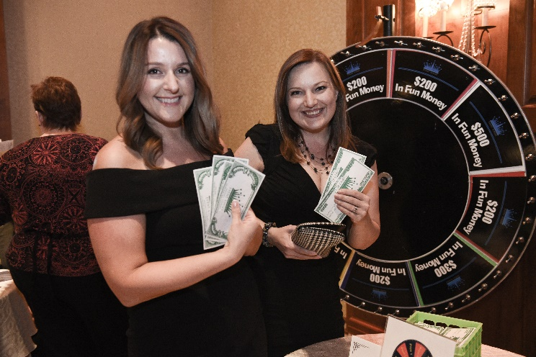
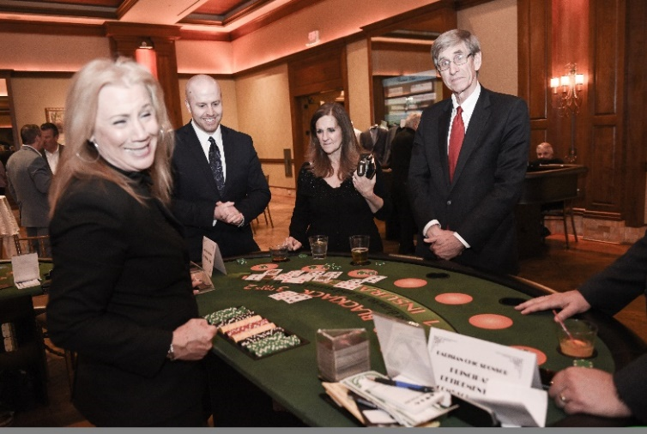
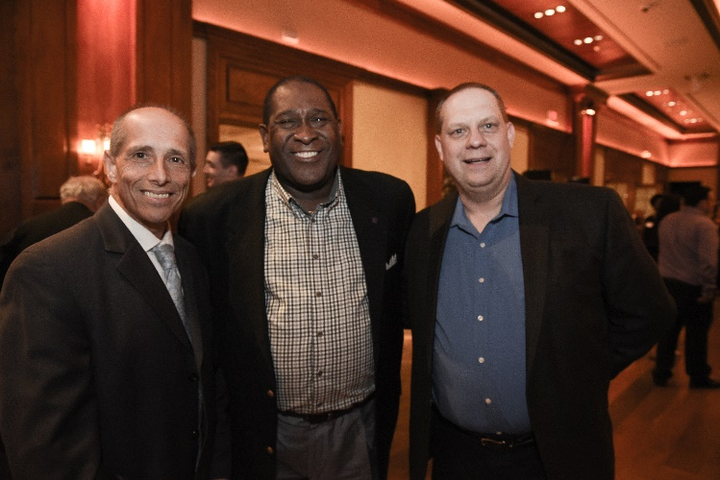
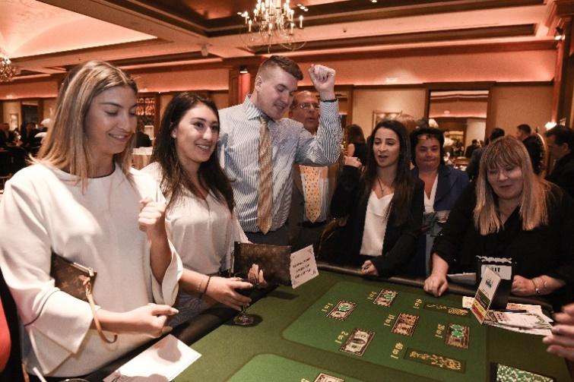
SPECIAL EVENTS
A Night In Monte Carlo
A Night in Monte Carlo
UCP of Long Island once again held its popular “A Night in Monte Carlo” event at the Larkfield in East Northport, NY on Wednesday, April 17, 2019. More than 280 friends and supporters were in attendance and thanks to their support $95,000 was raised.
A Night in Monte Carlo was made possible by its major sponsors: Sterling National Bank, The Carol and Arnold Wolowitz Foundation, Arbor Realty Trust, BNB Bank, Flushing Bank, Jackson Lewis P.C., Esquire Bank, Berdon Accountants and Advisors, The Pfundstein Family . The Lozzi Family, Cohn Reznick, Katz, Smith & CHWAT and Signature Bank.
The evening, filled with the excitement of Monte Carlo, featured a cocktail reception, followed by a delectable buffet dinner and extensive Viennese display. Guests enjoyed gaming by Event Kings, luxury cars courtesy of Ferrari-Maserati of Long Island and art pieces created by the talented artists of the UCP-LI Brushstrokes program. Fashion was provided by Popi’s Place and Edward Alan Big & Tall. Silent auction items and raffles also featured items by local jewelry designer, Stephanie Occhipinti Designs and Triple Crown Fundraising.

Slide 8
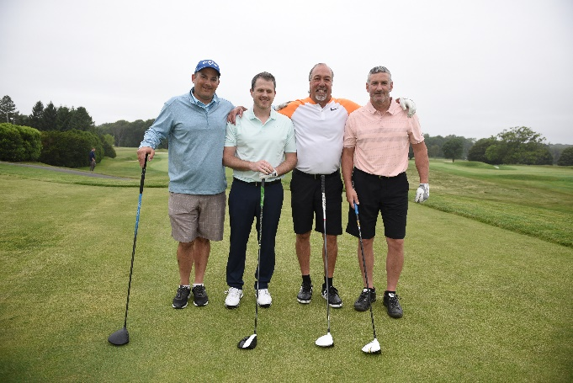
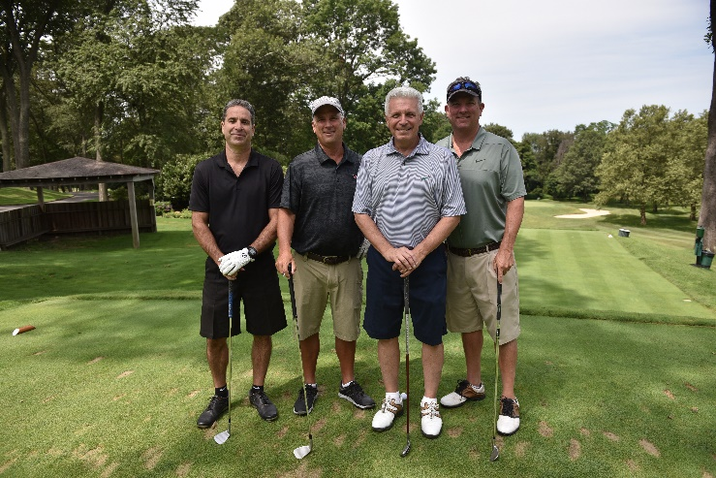
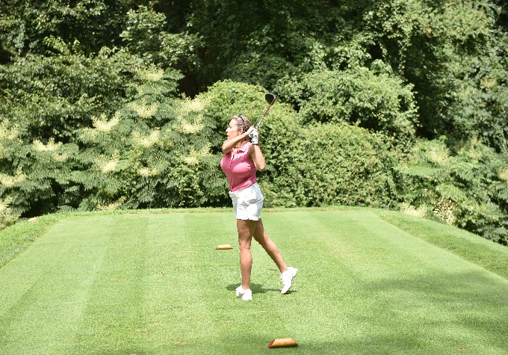
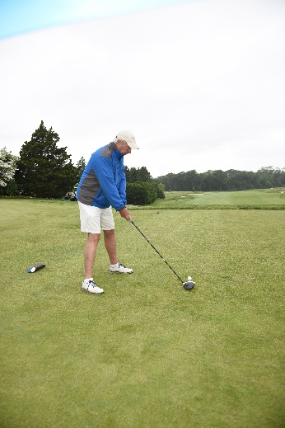
SPECIAL EVENTS
30th Annual Golf Classic
Gold Coast Invitational
UCP of Long Island held its 30th Annual Golf Classic at the Huntington Country Club on Monday, June 10, 2019. Although the weather was less than cooperative, the rain couldn’t dampen the enthusiasm and support for UCP’s mission. More than 100 friends and supporters joined us, and helped to raise over $101,000. The day included artwork that showcased the talents of UCP’s Brushstrokes artists, as well as a memorable Live Auction, that raise over $16,000.
UCP-LI thanks its Eagles sponsors, The Schaefer Agency & M&T Bank. UCP would also like to thank its Birdie Sponsors, Corporate Synergies, The Bernard Family and Professional Group Plans. Thanks to our Bogie sponsors, BNB Bank, CJM wealth Management, Emblem Health, NJM Insurance Group, Philadelphia Insurance Companies. We would like to thank Cigar Sponsor Risk Management International & Hole-In-One Sponsor, King O’Rourke.
UCP of Long Island raised over $101,000 at its annual Gold Coast Invitational held at the Cold Spring Country Club on Monday August 5, 2019, where Long Island businesses and friends gathered to honor Assemblyman Michael J. Fitzpatrick and his brother John P. Fitzpatrick, SVP of Investments at Morgan Stanley. The day began with a lovely Brunch, a shotgun start and many on course activities which made the day even more memorable.
UCP-LI thanks its Par sponsors, Moritt Hock & Hamroff LLP, Knockout Pest Control and New York Community Bank. Other contributing sponsors included Bethpage Federal Credit Union, BNB Bank, Carman, Callahan & Ingham, Onyx Packaging, The Culkin Family, The Egan Family, Emblem Health, Empire National Bank, Morgan Stanley, Katz, Smith & Chwat, The Fitzpatrick Family, People’s United Bank, The Pfundstein Family, Signature Securities, Shore Office Systems,VRD Contracting and The Winter Family.

Slide 9
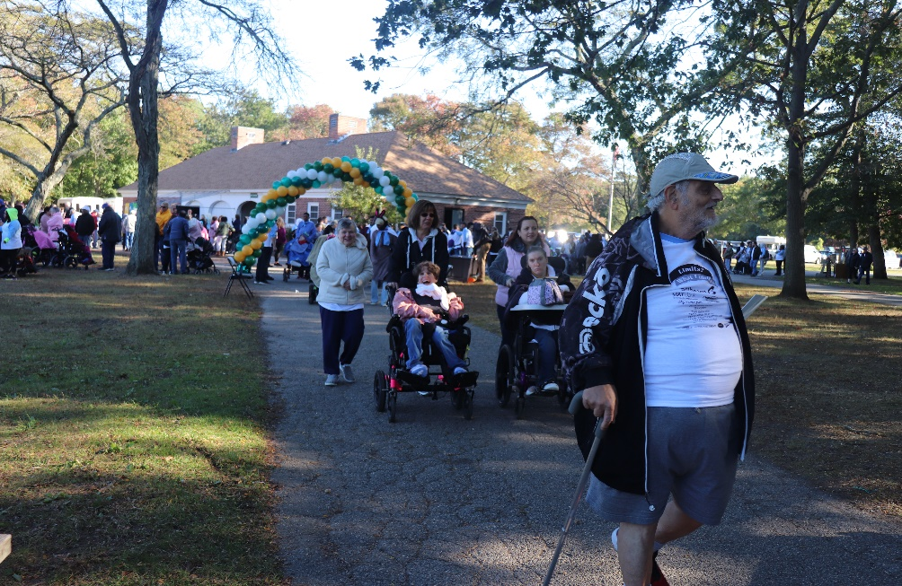
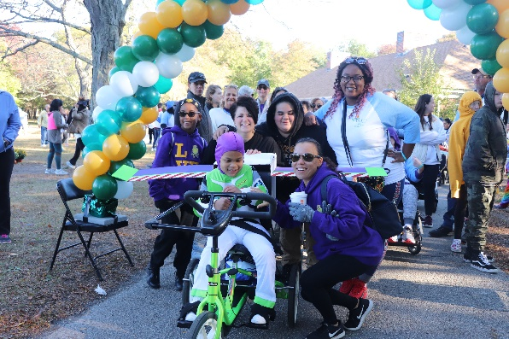
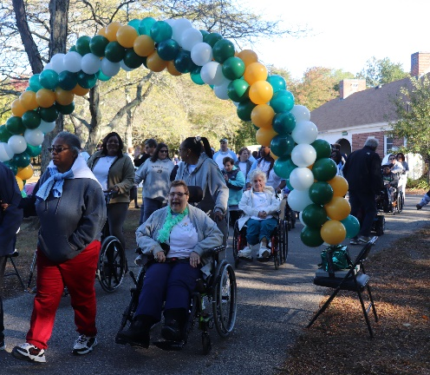
SPECIAL EVENTS
5K Walk & Wheel
Over 500 supporters came together to raise awareness at the UCP of Long Island Life Without Limits 5K Walk & Wheel which was held on Saturday, October 5, 2019 at Belmont Lake State Park. The event raised over $63,000. These funds will support the programs and services UCP of Long Island provides to children and adults with disabilities.
A special thank you to Bethpage Federal Credit Union for continuing to support UCP-LI as Presenting Sponsor. UCP is grateful to its other sponsors for support of this event: M&T Bank, Allergan, People’s United Bank and Home Medical Equipment. A special thank you to the Honor Society of Selden Middle School for once again holding a trivia contest in support of the UCP-LI 5K Walk & Wheel. The students raised over $1400. Also our thanks to Bagel Chalet, Driscoll Foods and W.B. Mason for providing the food and drinks.

Slide 10
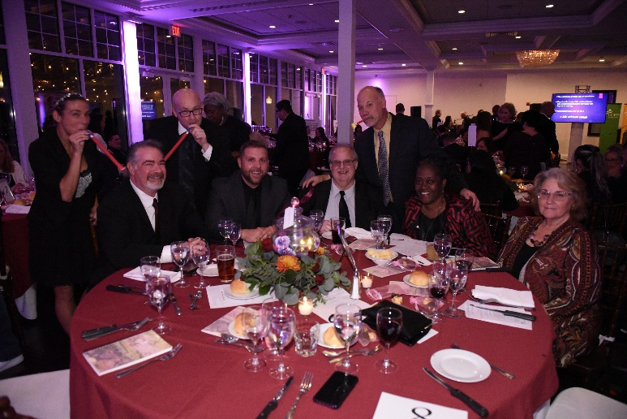
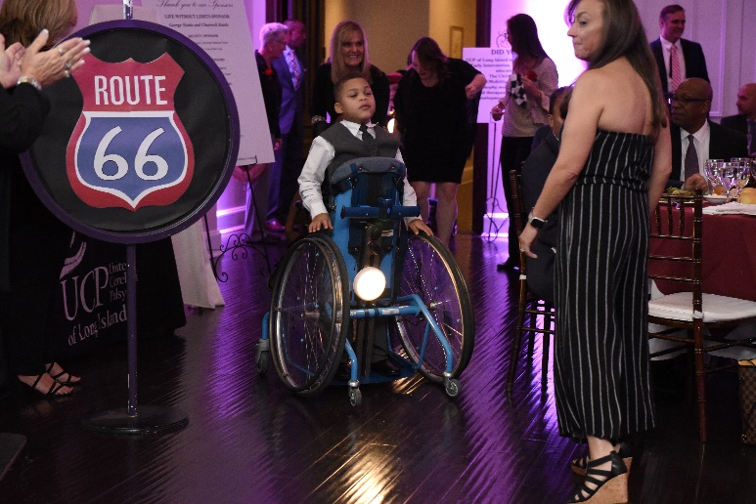
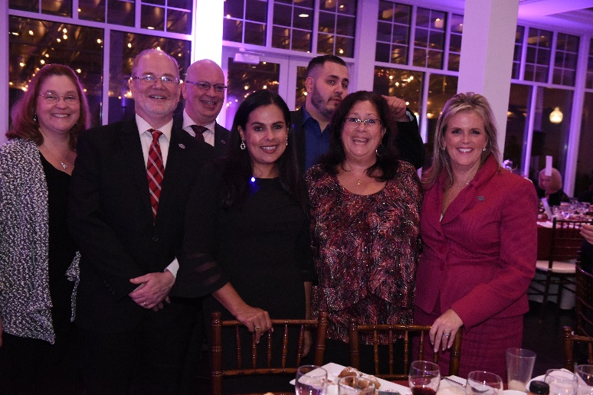
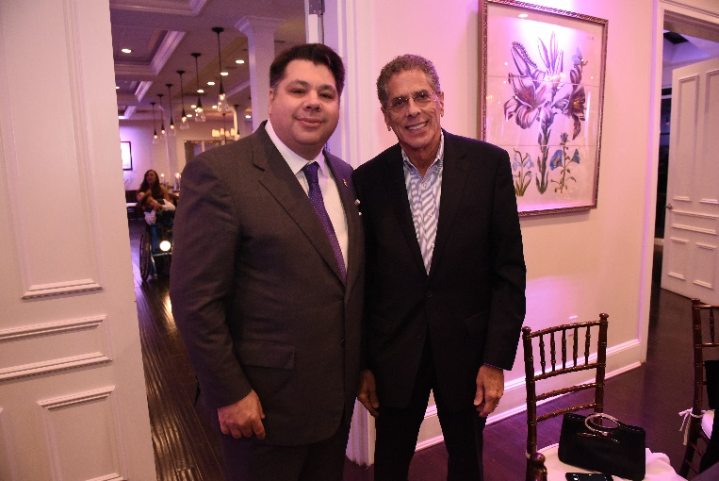
SPECIAL EVENTS
LIFE WITHOUT LIMITS
Gala
Life Without Limits Gala
UCP of Long Island held its annual Life Without Limits Gala on Thursday, October 24, 2019 at Stonebridge Country Club in Smithtown, NY. This year’s event honored George Tsunis, President of Chartwell Hotels. The event raised over $176,000 in support of the comprehensive programs and services that UCP of Long Island provides to thousands of children and adults with disabilities.
Students from the Children’s Center performed two magical song and dance numbers that captivated the entire audience. The evening also featured a moving tribute to Stephen H. Friedman, UCP-LI’s longtime President and CEO who passed away last year; Mr. Friedman was awarded UCP-s annual Life Without Limits award. The evening also included a reading of “Perspectives from A Wheelchair”, an essay written by one of our individuals Rolf W.
The formal event was co-chaired by Larry Levy, Executive Dean, Hofstra National Center for Suburban Studies and Carmen Tomeo, CEO of WE Transport. Steve Louro, CEO of Professional Group Plans served as Honorary Chair. The Life Without Limits Gala would not have been possible without the commitment of our generous sponsors: WE Transport/ Towne Bus / Van Trans LLC, Nassau Financial Federal Credit Union, Nassau Health Care Foundation, Inc., M&T Bank Foundation, and many more.

Slide 11
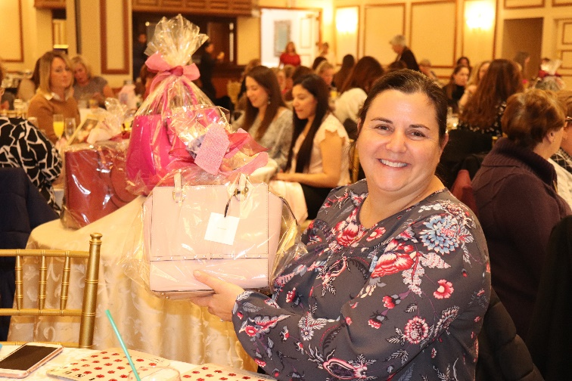
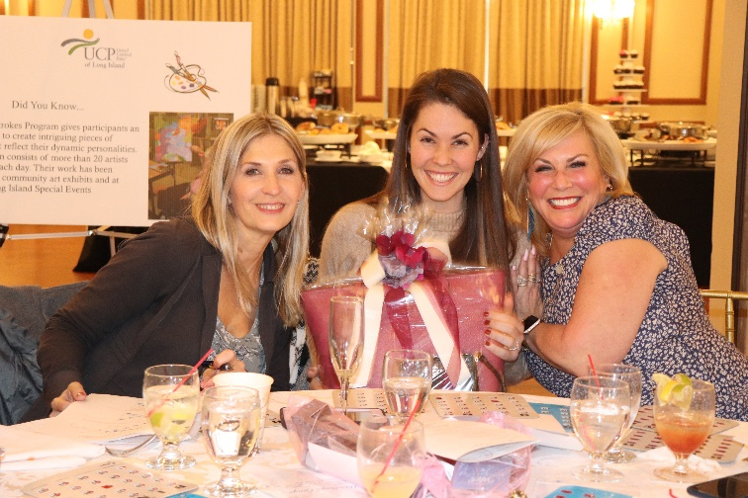
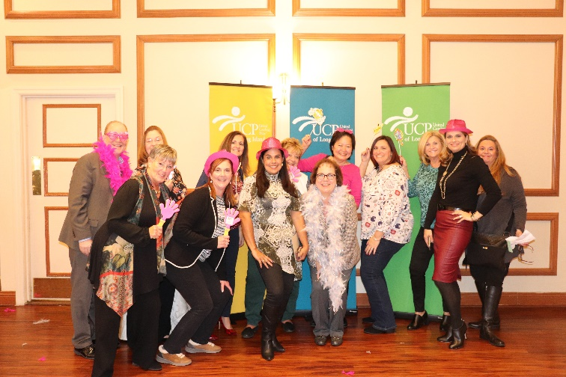
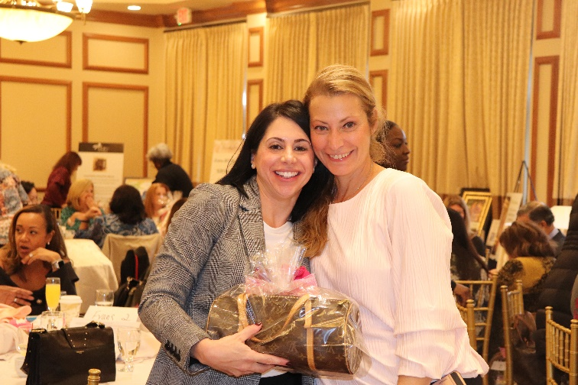
SPECIAL EVENTS
LIFE WITHOUT LIMITS
Gala
Handbag Bingo
UCP of Long Island held its annual Handbag Bingo event on Sunday, November 17, 2019 at the Hamlet Golf & Country Club in Commack, NY. The event raised over $25,000 in support of the comprehensive programs and services that UCP of Long Island provides to thousands of children and adults with disabilities.
This fast becoming favorite event was chaired by Teresa Evans, United Way of NYC which brings together 150 of Long Island’s prominent business men and women. Our guests enjoyed an elegant buffet brunch, mimosas with a chance to win a designer handbag all while supporting an amazing agency on Long Island.
The event would not have been possible without the commitment of our generous sponsors: BNB Bank, Contract Pharmacal Corp., M&T Bank and People’s United Bank.

Slide 12
DONORS
UCP of Long Island gratefully acknowledge all of the individuals and businesses whose donations
of $500 or more were received between January and December of 2019.
Your investment in UCP’s future is deeply appreciated!
$20,000 and Above
BNB Bank
M&T Charitable Foundation
$15,000-$19,999
Mr. John Fitzpatrick
Mr. Michael Fitzpatrick
Flushing Savings Bank
Knockout Pest Control, Inc.
Mr. and Mrs. Robert Lozzi
Moritt Hock Hamroff LLP
New York Community Bancorp- Mr. Patrick Egan
NJM Developers
Mr. and Mrs. Kenneth Obletz
People's Alliance Federal Credit Union
Rivkin Radler, LLP
Rubin Paterniti Gonzalez Kaufman
The Schaefer Agency, Inc.
United Way Of Long Island
Mr. Lon T. Dolber
Emblem Health Services, LLC
Empire National Bank
Fuller Lowenberg & Co., CPA's- Mr. Thomas Lowenberg
Furey & Furey, P.C.
Garfunkel Wild, P.C.
Gary Duff Designs, Ltd.
Genatt Associates Inc.
Health/ROI
Hofstra National Center for Suburban Studies
JA Marketing
Jackson Lewis P.C.
Katz, Smith & Chwat, P.C.- Ms. Kim Smith
Medford Chemists, Inc.
Mr. and Mrs. Sean G. Myles
Mr. Kerry Phelan
Mr. Dan Robinson
New York State Elks Association, Inc.
Onyx Packaging Corp.
Philadelphia Insurance
Shore Office Systems
Signature Bank
SIgnature Securities Group
Triple Crown Fundraising
True Earth Health Products LLC
VRD Contracting
Bethpage Federal Credit Union
Professional Group Plans Inc.- Mr. Stephen Louro
Sterling National Bank Charitable Foundation
WE Transport/Towne Bus Corp.
Mr. and Mrs. Barry Winter
$10,000-$14,999
CME Group Community Foundation
Mr. and Mrs. Patrick Egan
Nassau Financial Federal Credit Union
Nassau Health Care Foundation
People's United Bank
Mr. and Mrs. Thomas Pfundstein
Sterling National Bank
$5,000-$9,999
Mr. and Mrs. Robert Bernard
Carman, Callahan & Ingham, LLP- Mr. Michael Ingham
Carol & Arnold Wolowitz Foundation, Inc.
Corporate Synergies
$2,500-$4,999
Abrams Fensterman LLP
Dr. and Mrs. David A. Abroff
Allergan Neuroscience
Amwins Brokerage of New York
BDR Management Inc.
Mr. Dino Carfora
CJM Wealth Management LLC
Contract Pharmacal Corp.
Corieri & Associates, Inc.
Mrs. and Mr. Margaret M. Culkin

Slide 13
DONORS
$1,000-$2,499
Mr. Eric Goldsmith Mr. Glenn Glubiak Healthcare Management Solutions LLC Hine Bros international Hofstra University Mr. & Mrs. Michael Ingham Jackson Lewis LLP
Janney Montgomery Scott LLC
Ms. Janine C. Klein
Lessing's, INC.
Mr. Natale Lanza
Mr. & Mrs. Lawrence Levy
Lewis, Johs, Avallone, Aviles, LLP
Long Island FQHC Inc.
Mr. Jack Louro
Marshall & Sterling, Inc.
Mr. Peter McGuire
Medline Industries Inc
Metrolube
Ms. Margaret Negrelli
Mr. Richard Nespola
Network for Good
Ms. Karen E. O'Callaghan
Mr. Peter Pace
Mr. and Mrs. Leroy Peppard
Preemo Productions LLC
Quality Kings
Mr. & Mrs. William F. Regan, Jr.
Reuben Warner Foundation
Risk Management International
Rocco's Auto Transport
Ruskin, Moscou, & Faltischek
Ms. Megan Ryan
Mr. & Mrs. Gerard H. Schmitt
SMBC Global Foundation, Inc.
St. Joseph's College
Mr. and Mrs. Brian F. Stone
Tabat, Cohen, Blum & Yovino, PC
The Patchogue Theatre
Tritec Real Estate Company
Ms.Lisa Turk
Vanguard
Vinnie's Mulberry Street
Mr. and Mrs. George Vogel
West RAC Construction Corp.
Winter Bros.
Zabar's & Co., Inc.
Advantex Solutions, Inc.
All Points Bus Upholstery & Supplies,Inc.
Arbor Realty Trust
AssuredPartners Northeast, LLC
AXA Foundation
Barnwell House of Tires, Inc.
Berdon LLP
BK Fire Suppression & Security Systems
Bodies Unlimited Corp.
Brake Service Group
Channing P & Carol K Hayes Rev Tr
Ms. Adriana F. Cleveland
Cohn Reznick, LLP
Mr. & Mrs. Louis Commisso
Community Care Home Health Services
Mr. and Mrs. Andrew F. Corrado
Cozy Realty Inc.
Dayton & Sydney Wealth Strategies Grp., LLC
Mr. John Dolan
Engel Burman Group - The Bristol
Esquire Bank
Mr. & Mrs. Javier Evans
Factory Direct Bus & Truck Repair
Farrell Fritz, P.C.
Fidelity National Title Insurance Company
Mrs. Norma Friedman

Slide 14
DONORS
$500-$999
Triple Crown Logistics Inc.
Mr. Paul Vigliante
XpertSavers
Mrs. Narjis Zaidi
850 Atlantic Collision Inc.
AMR Landscaping Inc.
Andys Mel & Tony Auto Collision
Auto, Truck & Equipment, Inc.
Mr. Christopher J. Barber
Mr. and Mrs. Russell W. Bauer
Mrs. Jeanette M. Bienias
Mr. Evan Bloom
B&R Cesspool LLC
BGB Group LLC
Bonvi Realty, Inc.
Box Tops Education
Mr. Robert Buono
Mr. Lance Burke
Mr. Tony Camodeo
Cerini & Associates, LLP
Ms. Eileen Murphy-Cleary
CSEA Unit 7550-02 of Local 830
Eagle Auto Mall Sales Inc.
Ehrenman & Khan
Ms. Janet C. Fenstermacher
Ms. Rosemany Ferrara
Fleet Pride Truck & Trailer Parts
G Construction Enterprises LLC
General Securities Inc.
Guardian Life Insurance Company of America
Happy Hour 4 Kids
Home Medical Equipment LLC
Jet Sanitation Service Corp.
Kudrick’s Auto Repair, LTD
Local 1102 RWDSU
Mr. Carl Lombardi
Mr. Daniel Liberty
Mr.Jeffrey H Long
Mr. & Mrs. James Manseau
Mr. and Mrs. Brian Marksohn
Marsh Industrial, LLC
M&V Limousine
Montfort Healy
National Vision Administrators, NVA
Nesco Bus and Truck and Sales, INC.
New Empire Group, Ltd.
Mr. Kevin O'Connor
Parts Authority
Mrs. Mary Ann Petrulo
Mrs. Ellen Pfundstein
Mr. and Mrs. Kevin Pfundstein
Mr. and Mrs. Paul Pfundstein
R.A. Cohen & Associates, Inc.
Mr. Christopher Reinhardt
Mr. and Mrs. Steve E. Schramm
Sparklers, The
Ms. Lisa Stapleton
Suffolk Auto Glass Inc.
Syosset Truck Sales Inc.
Tonsa Automotive

Slide 15
FINANCIALS
2020 ANNUAL BUDGET $54,188,590
Total Program Expenditures |  | $ 46,894,000
Total Fundraising Expenditures |  | $ 439,400
Total Administrative Expenditures |  | $ 3,566,200
Total Expenditures |  | $ 50,899,600
ENDING NET ASSETS AS OF 12/31/19 $12,740,988

Slide 16
LEADERSHIP
Stephen H. Friedman
President & CEO
Janine Klein
Chief Financial Officer
Adriana Cleveland
Director of Residential Services, ICF
Mark Crean
Director of Adult Services
Jayne Mancusi
Director of Human Resources
Jason Rawcliffe
Director of Facilities
Camille Schramm
Director of Development and Public Relations
Ingrid Trouve
Director of Educational Services
Narjis Zaidi
Director of Residential Services, IRA

Slide 17
LEADERSHIP
BOARD OF DIRECTORS
Thomas Pfundstein
Board Chair
Robert Bernard
Vice Chair, Audit & Compensation
Michael F. Ingham Esq.
Vice Chair, Policy & Compliance
Thomas Lowenberg, CPA
Vice Chair, Budget & Finance/Treasurer
Colleen West-Levy
Recording Secretary
Gerard Schmitt
Vice Chair, Membership & Development
DIRECTORS
Andrew Corrado Stephen M. Louro
Patrick Egan James Manseau
Javier Evans Paula Neyssen (in memoriam)
Lawrence Levy Kim M. Smith
Patricia Tutiven

